Slide 1

Basic Views, Layouts, Menus
Copyright© Jeffrey Jongko, Ateneo de Manila University

Slide 2
Overview
View Concepts
Basic Views
Basic Layouts
UI Handling
Basic Menu Handling
Toasts

Slide 3
View Concepts

Slide 4
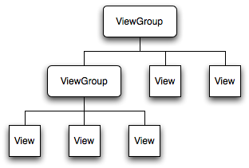
Android: View Hierarchy
When creating a UI layout, it is represented as a tree of View objects and ViewGroups (layouts)
When defining a view or layout in XML, you must decide if you wish to access this view from within your code
  E.g. to get the value stored inside a TextBox

Slide 5
IDs
IDs are the means by which you can access a specific view in a hierarchy
IDs are special in Android, they are auto-generated constants so you can use Eclipse auto-complete (Ctrl-space) to use them
  These are stored in the auto-generated R file
  Your project package has a specific R file associated to it
    E.g. admu.edu.cs119.R
    Make sure you have imported the correct one

Slide 6
Retrieving Views from the XML
When you define views inside an XML there are times you need to pull one of them out
To do this you will need to supply an id to the view
  Using using @+id/<identifier> in the view
    E.g. android:id="@+id/text“
  This view may then be retieved using findViewById(int id)
  Once you have the view you can then access the data inside it

Slide 7
Typical things you do to views
Adding listeners
  E.g. for clicking, focus checking
Extracting values
  E.g. for EditViews(text box)
Setting values
  E.g. forcing a checkbox to a certain state

Slide 8
Basic Views
Copyright© Jeffrey Jongko, Ateneo de Manila University

Slide 9
Views
Basic Views
  TextView
  Buttons
  EditText
  CheckBox
  RadioButton

Slide 10
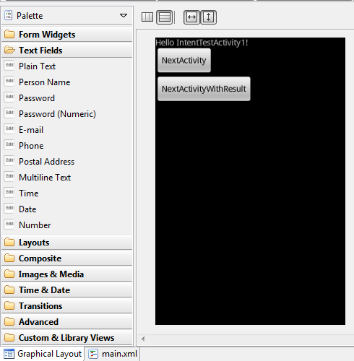
Graphical Editor
The graphical editor allows for drag-and-drop creation of static user-interfaces
All widgets and layouts described here are located under Form Widgets, TextFields, Layouts

Slide 11
TextView
Aka a label
A single block of text that can displayed over multiple lines

Slide 12
Button
A basic clickable view
Can hold an icon and some text
Can have customized backgrounds

Slide 13
EditText
EditText is simply a TextView that has been configured to be editable
Different types of pre-configured EditTexts are available in the TextFields group of the Graphical Editor
  Plain Text
  Password
  Phone Number
  etc

Slide 14
Using EditText
Pre-configured EditTexts handle their own validation internally
  E.g. Phone numbers only accept numbers and select characters

Slide 15
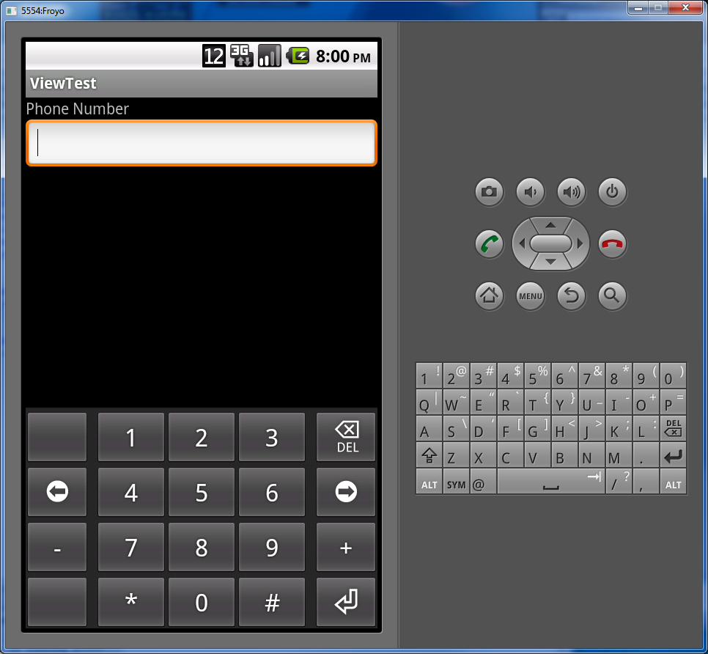
Example
Here is an example of a Phone Number- style EditText
  The keypad is set for number and phone-related characters like ‘+’

Slide 16
Example
<EditText android:id="@+id/editText1"
android:layout_height="wrap_content"
android:layout_width="match_parent"
android:inputType="phone">
<requestFocus></requestFocus>
</EditText>
In the XML file built-in validation is controlled by the android:inputType attribute
Hit Crtl-space in the XML to see other values you can use

Slide 17
Extracting text
final EditText edittext = (EditText) findViewById(R.id.edittext);
String s = edittext.getText().toString();
To retrieve contents of the EditText use
  getText().toString()
    Note: getText() itself does not return a String so you cannot just typecast the output

Slide 18
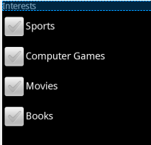
CheckBox
CheckBoxes are used to indicate selection of a specific option
  Boolean type state
Checkboxes are used for non-mutually exclusive states
  You can select any, all or none of the options
The state of the CheckBox can be determined using isChecked()

Slide 19
Example
final CheckBox checkbox = (CheckBox) findViewById(R.id.checkbox);
checkbox.setOnClickListener(new OnClickListener() {
public void onClick(View v) {
if (((CheckBox) v).isChecked()) {
// check action
}
else {
// unchecked action
}
}
});
Alternatively, you may wait for the box to be checked by using an View.OnClickListener like with a Button

Slide 20
Alternative
final CheckBox checkbox = (CheckBox) findViewById(R.id.checkbox);
if (checkbox.isChecked()) {
// check action
}
else {
// unchecked action
}
If you don’t want to use an OnClickListener, you may also pullout the CheckBox from the form using findViewById(int id) and then use the isChecked() afterwards
Note: this will only be useful when you are about to finish() the current Activity

Slide 21
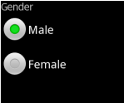
RadioButton / RadioButtonGroup
RadioButtons unlike CheckBoxes are meant to be used on data where only a single selection is allowed from the list
RadioButtons are managed by a RadioButtonGroup
  Controls the state of the radio buttons, if one is pressed, the group unsets the others in the group

Slide 22
Example
<RadioGroup
android:layout_width="fill_parent"
android:layout_height="wrap_content"
android:orientation="vertical">
<RadioButton android:id="@+id/radio_red"
android:layout_width="wrap_content"
android:layout_height="wrap_content"
android:text="Red" />
<RadioButton android:id="@+id/radio_blue"
android:layout_width="wrap_content"
android:layout_height="wrap_content"
android:text="Blue" />
</RadioGroup>
NOTE: the radio buttons must be in a radio group to function properly (only one selection)

Slide 23
Example
final RadioButton rb = (RadioButton) findViewById(R.id.radio1);
rb.setOnClickListener(new OnClickListener() {
public void onClick(View v) {
if (((RadioButton) v).isChecked()) {
// check action
}
else {
// unchecked action
}
}
});
Alternatively, you may wait for the box to be checked by using an View.OnClickListener like with a Button or CheckBox

Slide 24
Note
You may also programmatically control radio button state
  If you need to change the state yourself, use the setChecked(boolean) or toggle() method
You may also use the RadioButtonGroup to change state
  check(int id)
    Id is the id of the radio button
  clearCheck()
    Clears the whole group

Slide 25
Android: Custom Views
You can create your own custom widgets
  How? Extend existing View class or subclass
These can be used in the XML editor by writing the fully qualified name in the XML tag

Slide 26
Sample
<com.stylingandroid.ScrollingTable.ScrollingTable android:layout_width="match_parent" android:orientation="vertical" android:layout_weight="1" android:layout_height="match_parent">
….
</com.stylingandroid.ScrollingTable.ScrollingTable>

Slide 27
Basic Layouts
Copyright© Jeffrey Jongko, Ateneo de Manila University

Slide 28
Basic Layouts
Android has several built-in Layouts
  LinearLayout
    Either vertically or horizontally placing Views one after another
  RelativeLayout
    Placing views relative to the position of another view

Slide 29
layout_width and layout_height
These View XML attributes are usually used in reference to the container layout
  Both use one of the following values
    match_parent / fill_parent (depending on OS version, either will work in newer Android OS versions) – fills to match width of the layout
    wrap_content – sizes according to the minimum required size of the content of the View
Note: you can also use these on regular Views not just layouts to control their dimensions

Slide 30
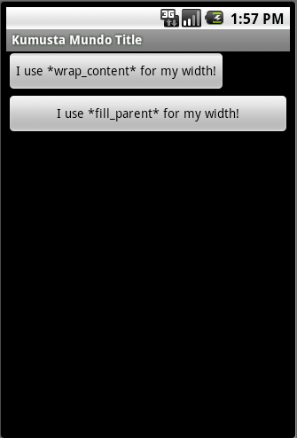
Android: Layout
What’s the difference between:
wrap_content and fill_parent?

Slide 31
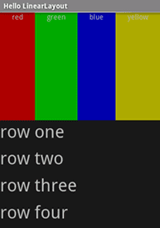
LinearLayout
LinearLayout is a ViewGroup that displays child View elements in a linear direction, either vertically or horizontally.
You should be careful about over-using the LinearLayout. If you begin nesting multiple LinearLayouts, you may want to consider using a RelativeLayout instead

Slide 32
layout_gravity
In addition to the basic layout_height and layout_width, Widgets also have a layout_gravity attribute to indicate which side to align the widget within the space assigned to it
Takes values such as
  top
  bottom
  left (default)
  (see Eclipse auto-complete for others)

Slide 33

Example
<LinearLayout xmlns:android="http://schemas.android.com/apk/res/android"
android:orientation="vertical"
android:layout_width="fill_parent"
android:layout_height="fill_parent"
>
<TextView
android:layout_width="fill_parent"
android:layout_height="wrap_content"
android:text="RIGHT"
android:gravity="right"/>
<TextView
android:layout_width="fill_parent"
android:layout_height="wrap_content"
android:text="LEFT"
android:gravity="left"/>
</LinearLayout>
NOTE: Use of gravity varies according to widget or layout
  Sometimes it is ignored

Slide 34
layout_weight
LinearLayout also supports assigning a weight to individual children.
This attribute assigns an "importance" value to a view
  allows it to expand to fill any remaining space in the parent view.
  Widgets with the same weight will shared the extra space equally
Child views can specify an integer weight value, and then any remaining space in the view group is assigned to children in the proportion of their declared weight.
  Default weight is zero.

Slide 35
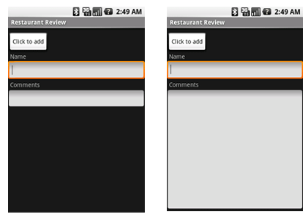
Example
  With all weights left as default
  With the weight of the second textbox set to 1 with all the others set to 0(default)

Slide 36
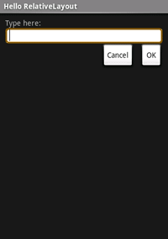
RelativeLayout
RelativeLayout is a ViewGroup that displays child View elements in relative positions. The position of a View can be specified as
  relative to sibling elements (such as to the left-of or below a given element)
  in positions relative to the RelativeLayout area (such as aligned to the bottom, left of center).
A RelativeLayout is a very powerful utility for designing a user interface because it can eliminate nested ViewGroups

Slide 37
Example
<RelativeLayout xmlns:android="http://schemas.android.com/apk/res/android"
android:layout_width="fill_parent“ android:layout_height="fill_parent">
<TextView
android:id="@+id/label” android:layout_width="fill_parent“ android:layout_height="wrap_content"
android:text="Type here:"/>
<EditText
android:id="@+id/entry“ android:layout_width="fill_parent” android:layout_height="wrap_content"
android:layout_below="@id/label"/>
<Button
android:id="@+id/ok“ android:layout_width="wrap_content“ android:layout_height="wrap_content"
android:layout_below="@id/entry"
android:layout_alignParentRight="true"
android:layout_marginLeft="10dip"
android:text="OK" />
<Button
android:layout_width="wrap_content“ android:layout_height="wrap_content"
android:layout_toLeftOf="@id/ok“ android:layout_alignTop="@id/ok"
android:text="Cancel" />
</RelativeLayout>

Slide 38
RelativeLayout attributes
Some relative layout xml attributes:
  android:layout_above - Positions the bottom edge of this view above the given anchor view ID.
  android:layout_alignBaseline - Positions the baseline of this view on the baseline of the given anchor view ID.
  android:layout_alignBottom - Makes the bottom edge of this view match the bottom edge of the given anchor view ID.
  android:layout_alignLeft - Makes the left edge of this view match the left edge of the given anchor view ID.
A complete list can be found in the /docs
  file:///C:/android-sdk-windows/docs/reference/android/widget/RelativeLayout.LayoutParams.html

Slide 39
Nesting Layouts
Layouts can be nested within each other to form complicated groupings of widgets
  This is normally required when you want to control the layouting of a group of widgets as a single entity

Slide 40
UI Events

Slide 41
Android: UI Events
To determine whether a user has interacted with your UI (so you can perform appropriate actions)
Either of these 2 things:
1) “Define an event listener and register it with the View”
- onClickListener(), setOnClickListener(…)
2) Specify in the XML the android:onClick attribute

Slide 42
Android: UI Events (Java)
public void initUIEventHandling()
{
myTextView = (TextView)findViewById(R.id.my_textview);
myButton = (Button)findViewById(R.id.my_button);
myButton.setOnClickListener(new OnClickListener() {
@Override
public void onClick(View v) {
myTextView.setText("Button clicked!");
}
});
}
Be sure that you have my_textview and my_button ids in the XML layout that you attached to your Activity using setContentView(…)!

Slide 43
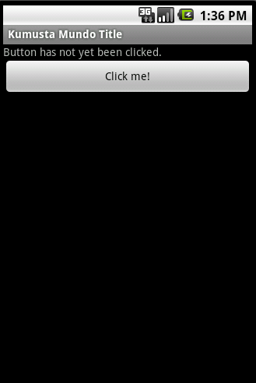
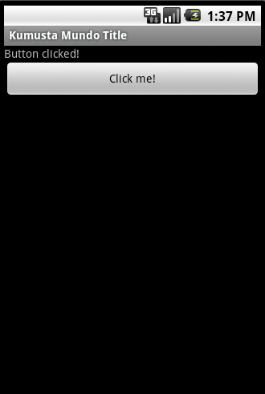
Android: UI Events (Output)

Slide 44
Alternative
Views now have an android:onClick attribute
This can be used to specify a method name that Android will search for in your Activity
The method signature needs to follow a specific form.

Slide 45
Alternative
If a button defines android:onClick=“clickMe”, you need to have this method in your activity
public void clickMe(View view)
{
}

Slide 46
Alternative
You can assign the same method name to multiple views if you like, you can use the passed view’s id to determine which was pressed
public void clickMe(View view)
{
switch(view.getId())
{
case R.id.button1: break; case R.id.button2: break;
}
}

Slide 47
Menus

Slide 48
Android: Menus
Menu’s can be triggered by hitting the menu button or the “triple dot” (in newer phones)
Option Menus (most common)
  revealed by pressing MENU key in the device
    onCreateOptionsMenu()
    onOptionsItemsSelected()
“Menus also handle their own events, so there’s no need to register event listeners on the items in your menu.”
You can declare your menu items in XML

Slide 49
Android: Menus (XML)
<menu xmlns:android="http://schemas.android.com/apk/res/android"
>
<item android:id="@+id/start"
android:title="Start"
/>
<item android:id="@+id/quit"
android:title="Quit"
/>
</menu>

Slide 50
Android: Menus (Java)
public class MenuActivity extends Activity {
@Override
public void onCreate(Bundle savedInstanceState) {
super.onCreate(savedInstanceState);
setContentView(R.layout.menu);
}
@Override
public boolean onCreateOptionsMenu(Menu menu)
{
MenuInflater inflater = getMenuInflater();
inflater.inflate(R.menu.my_menu, menu);
return true;
}
}
For R.menu.my_menu, create in res folder a “menu” folder in the same level as “layout”, etc
Inflation is the act of turning an XML into some Java object or “filling in” an existing one, in this case, a Menu

Slide 51
Sample menu handling
@Override
public boolean onOptionsItemSelected(MenuItem item) {
  switch(item.getItemId())
  {
  case R.id.start:
  Toast.makeText(this, “Start”, Toast.LENGTH_LONG).show();
  break;
  case R.id.quit:
  Toast.makeText(this, “Quit”, Toast.LENGTH_LONG).show();
  break;
  }
return true;
}
A Toast is a small pop-up message that appears then vanishes

Slide 52
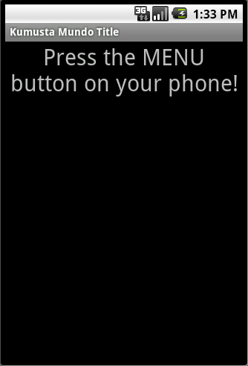
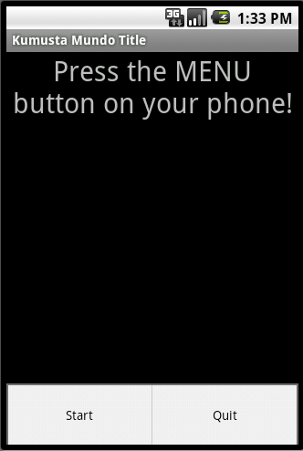
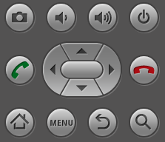
Android: Menus (Output)

Slide 53
Toasts
Copyright© Jeffrey Jongko, Ateneo de Manila University

Slide 54
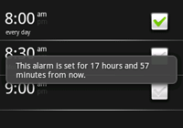
Toasts
A Toast what is used to represent a “pop-up” message
Toasts cannot be interacted with
  They just display the message embedded in them for a specified amount of time then disappear
  Cancel and other button do not do anything

Slide 55
Creating a Toast
To instantiate a Toast object use one of the makeText() methods.
This method takes three parameters: the application Context (usually the Activity), the text message, and the duration for the toast.
  It returns a properly initialized Toast object.

Slide 56
Toasts
Toasts are usually used to display simple messages
    E.g. Validation errors or short confirmations
Toasts have two possible fixed durations
  Toast.LENGTH_LONG
  Toast.LENGTH_SHORT
Messages should be short enough to read in this time frame

Slide 57
Example
Toast toast = Toast.makeText(this, “Hello”, Toast.LENGTH_SHORT);
toast.show();
Once a Toast instance is created you may make it appear using show()
The context parameter is the enclosing Activity

Slide 58
Positioning Toasts
A standard toast notification appears near the bottom of the screen, centered horizontally.
You can change this position with the setGravity(int, int, int) method.
This accepts three parameters: a Gravity constant (anchor), an x-position offset, and a y-position offset from the upper left.
toast.setGravity(Gravity.TOP|Gravity.LEFT, 0, 0);

Slide 59
Coming soon
Switching Activities via Intents
Passing data from activity to activity
App Deployment

